Slide 1
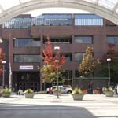
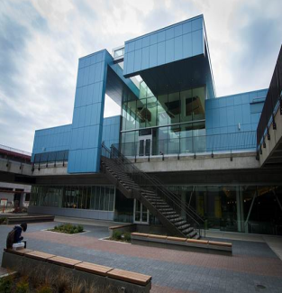
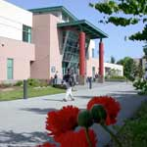
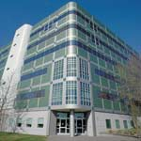
Central
SEATTLE COLLEGES
North
Public Budget Hearing
Fiscal Year 2014 - 2015
South
Presented June 11, 2014
South Seattle College
Olympic Auditorium
Dr. Jill Wakefield, Chancellor
SVI

Slide 2
Mission
Seattle Community Colleges
will provide excellent, accessible educational opportunities
to prepare our students for a
challenging future.

Slide 3
Strategic Plan 2010-2015
GOAL 1 – STUDENT SUCCESS
Increase Student Learning and Achievement:
Meet annual state-funded enrollment allocation Achieve 100% of our enrollment target
Increase student completion and job placement
Improve student achievement in pre-college math
Notes:
We achieved 96% of our enrollment target this year and if we had achieved 100% we would have increased tuition revenue by _______

Slide 4
Strategic Plan 2010-2015
GOAL 2 - PARTNERSHIPS
Build Community, Business and Educational Partnerships:
Increase awareness of the significant economic impact of the Seattle Community Colleges
Increase professional-technical program graduates to respond to local industry workforce needs
Increase private, foundation and local funding

Slide 5
Strategic Plan 2010-2015
GOAL 3 - INNOVATION
Increase innovation & improve organizational effectiveness:
Increase innovative instructional options for students
Improve effectiveness, efficiency and responsiveness of administrative systems
Increase employee ethnic and racial diversity and recognition

Slide 6
Seattle Colleges Budget Conversations
FY1415 Budget Themes
Focus on Enrollment and Student Success
Higher Faculty and Staff wages
Flat state budget – limited increase in State Allocation
Tuition remains the same for the third year
Performance-based funding

Slide 7
District Priorities for this Year
FY1415 Budget Priorities
Enrollment
Student Success Initiatives
Preparation for Major Fund-raising Campaign
Continued BAS Development
Education Plan
Multi-year

Slide 8
SEATTLE COLLEGES
Public Budget Hearing
Fiscal Year 2014 - 2015
Financial Outlook
Dr. Kurt Buttleman
Vice Chancellor, Finance & Technology

Slide 9
State Funding
State Funding Outlook
Tuition Increases caused by State Funding reductions
Since 2009, Community & Technical Colleges have had their state funding reduced by 23.5%
Flat Budget this year
Partial Reinstatement of budget cuts last year
None this year
Education
Legislative Priority
K-12 to increase teacher’s salaries
Continued reductions
For 15-17 planning
23.5%

Slide 10
FY1415 Budget Outlook
Key Updates to the State Allocation
Performance Funding (Student Achievement Awards)
Targeted enrollments
MESA / STEM - $60,000
Aerospace - tbd
Worker Retraining Increase - $61,500
Step M for Classified Staff - $70,878
Reduction in Retirement Payments – ($37,333)
Increase in Maintenance & Operations for new buildings

Slide 11
FY1415 Budget Outlook
Financial Management at Seattle District
Viable Financial Model
Long Range Planning
International Exchange
Board of Trustees Priority
Planning for Negotiated Contracts

Slide 12
District Office & District-Wide
Key Discussions
Focus on Strategic Goals of Student Success, Building Partnerships, and Innovation
Creative Funding options such as grants and contracts
Focus on streamlining administrative activities
Flat Budget planning

Slide 13
District Office and District-wide
Funding Themes
Capital campaign
Enterprise IT
Marketing and enrollment
Sustainability
Efficiencies

Slide 14
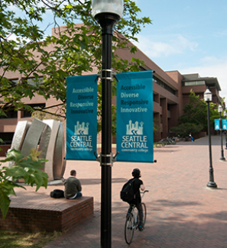
SEATTLE CENTRAL
Public Budget Hearing
Fiscal Year 2014 - 2015
Financial Outlook
Michael Pham
Vice President, Administrative Services

Slide 15
SEATTLE CENTRAL
Summary
The College initially planned for a FLAT budget with no changes to permanent funding.
College Council drafted budget planning themes of sustaining FTE generation & employee engagement.
College Council also drafted priorities for one-time funding around facility/safety enhancements and efficiency improvements.
Declining State FTEs (Central 92%, SVI 72%)
International student enrollment continues to be strong (headcount ~2,000)

Slide 16
SEATTLE CENTRAL
One-Time Budget Funding
President’s Cabinet approved ~$320K for one-time funding requests (classroom technology upgrades, safety enhancements, & facility/custodial equipment.)
President’s Cabinet also approved ~ $120K for minor capital projects for various instruction & classroom enhancements.

Slide 17
SEATTLE CENTRAL
NEW Positions
To be funded by increasing off-set contributions
2 FT Faculty (Business & English)
1 FT Maintenance Mechanic
1 FT Public Safety / Security Officer
Funding TBD
1 Dean of Nursing
1 Vice President of Student Services

Slide 18
SEATTLE CENTRAL
What’s Ahead
Must address ENROLLMENT issues
International Education Programs
SVI, Pacific Tower, Wood Tech, & SMA
Potential 2015-17 biennium budget cuts

Slide 19
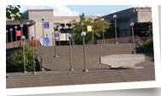
NORTH SEATTLE
Public Budget Hearing
Fiscal Year 2014 - 2015
Financial Outlook
Dr. Orestes Monterecy
Vice President, Administrative Services

Slide 20
NORTH SEATTLE
Financing Our Road Trip to 2016 The Second Leg of our Journey: 2014 - 2015

Slide 21
NORTH SEATTLE
Destination 2016
Year | Report | Focus
2015-16 | Year 6 | Core Themes, Objectives, Indicators Summative Assessment
2014-15 | Year 5
2013-14 | Year 4
2012-13 | Year 3 | Resources
2011-12 | Year 2
2010-11 | Year 1 | Core Themes
Aligning strategies & resources to achieve objectives

Slide 22
NORTH SEATTLE
Strategic Plan

Slide 23
NORTH SEATTLE
Budget Inputs
From College Council
Budget Advisory Committee
Department and Division Budget Managers
Presidents and VPs review and decide
President and VPs
Departments/Divisions
College Council
Budget Advisory Committee

Slide 24
NORTH SEATTLE
Advancing Student Success
Permanent
Evening Student Services Manager
Development Ed. Advisor
Orientation Advisor
Temporary
Saturday Testing

Slide 25
NORTH SEATTLE
Excellence in Teaching and Learning
Permanent
Full-time Faculty (6 positions: Adult Basic Ed/GED, BAS-Application Development, Electronics, Library, Medical Assisting, Parent Education)
BAS-AD Manager
Learning Center Manager (title change)
Science Lab Technician 1 (fee funded)
Temporary
Nursing Simulation Technician
Learning Center Staff (20 hours)
Art Gallery Staff (19 hours)
BAS Program Funding Positions
BAS International Business,
BAS Application Development,
BAS Property Management

Slide 26
NORTH SEATTLE
Building Community
Permanent
Custodian 1
Fiscal Specialist
Temporary
Safety & Security PT (11PM – 7AM, M-F)
Other Priorities
President’s Office Front Desk
Retire Long-term Food Service Deficit
LDI - Leadership Development Institute (AFS Funded)

Slide 27
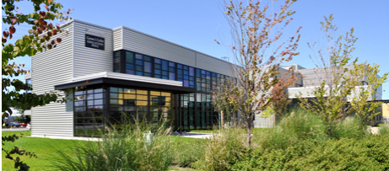
SOUTH SEATTLE
Public Budget Hearing
Fiscal Year 2014 - 2015
Financial Outlook
Dr. Frank Ashby
Vice President, Administrative Services

Slide 28
SOUTH SEATTLE
South had a GREAT Year
Accreditation
Name Change
Vigor Training Center
BAS new programs development and rollout
13th Year new schools
Around the campus
Online schedule rollout
Student Loan program
WorkSource expansion to GT

Slide 29
SOUTH SEATTLE
Budget Challenges
No increase in State Appropriation
State allocation is not finalized
No tuition increase
No relief in FTE target
Soft enrollment
Maxed on cost recoveries
Mandatory commitments

Slide 30
SOUTH SEATTLE
SCC Core Themes
Student Achievement
Teaching and Learning
College Culture and Climate
Community Engagement and Partnership

Slide 31
SOUTH SEATTLE
2014-15 FY Strategic Budgeting
INCREASE Enrollment, Retention, and Completion
Preserve quality of education
Achieve maximum efficiency

Slide 32
SOUTH SEATTLE
College Council
Recommend proposals with overall support of 80% or more
Made comments for additional consideration on proposals that did not make the threshold
“It is clear that in order to remain sustainable, we need people and resources”

Slide 33
SOUTH SEATTLE
Budget Balancing Strategies
Requests total $1.4 Million
Cost Shifts
Efficiencies
New Revenue
Carry Forward

Slide 34
SOUTH SEATTLE
Approved Revenue Changes
Increased BAS Tuition
Move PSIEC Director to Self-Support
PTF Pool Reduction
Eliminate printing and mailing of class schedule

Slide 35
SOUTH SEATTLE
Approved New Changes
NEW Associate Dean GT campus
NEW BAS FTF Sustainable Building
NEW Administrative Support BO&IT
Director of Web Services
NEW Program Coordinator BAS, BAS & FAO
NEW Program Coordinator DSS
NEW Hourly Lab Aid Welding
NEW Custodian
Educational Planner from grant 25% (2)
Student Services position at GT
NEW Grounds Specialist
NEW Hourly Support in Arboretum

Slide 36
SOUTH SEATTLE
Approved New Changes - Projects
Apprenticeship Contracts
SBST BAS
Classified Increments
Distance Learning CANVAS
Academic program (AD & G&S)
Staff Development
Automotive Program Coordination
Childcare hourly increase
Dean of Tech Ed. Travel
Aviation Travel
Security & Transportation G&S
Increase lease
DSS & Tutoring Center split G&S & travel
Logistics Program Coordination
Media monitors for classroom podium
Advising Center G&S
13th Year support G&S
FAO travel
Student Outreach travel

Slide 37
SOUTH SEATTLE
Summary
Budget is spending authority
Meet enrollment target
Serve students
Invest in growth
Support infrastructure
Be prepared for changes

Slide 38
Budget Hearing
Questions & Discussion?
Thank you all for attending

